Slide 1
Automated Scientific Knowledge Extraction Formulation Inference and Design of Experiments
Eric Davis, Alec Theriault, Ryan Wright
https://github.com/GaloisInc/AMIDOL/
This research was supported by the ASKE program under
DARPA-PA-18-02-AIE-FP-039

Slide 2





Artifacts
Universal
Actionable
Abstract
Knowledge
Papers
Visualization
Structured
Knowledge
Executable
Knowledge
Code
Execution

Slide 3
The Burden of Working with the Structural Knowledge Layer
The goal of the Abstract Knowledge Layer is removing the burden of working with formal mathematical models from the domain expert.
Right now domain experts have to be trained as:
Mathematicians
Statisticians
Software engineers
And their own domain
This is an unacceptable burden, and creates unrealistic expectations.
Leads to bad implementations and/or serious errors.

Slide 4




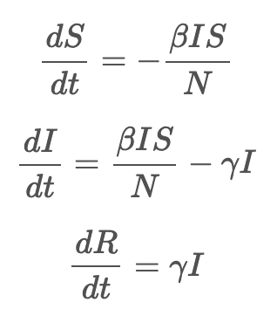
High Level Abstractions

Slide 5
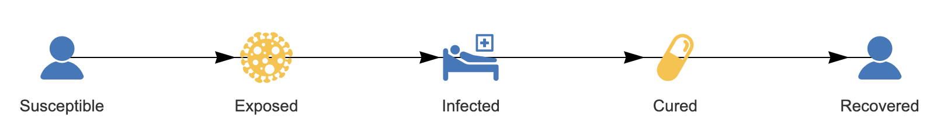
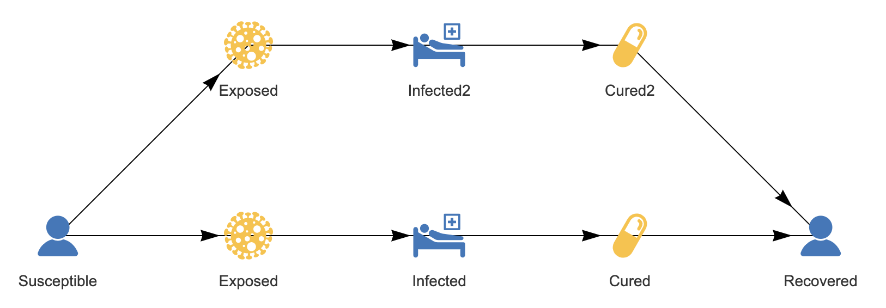
Formulations using VDSOLs
Visual Domain Specific Ontological Languages
High level abstractions.
Many ways of writing the same concept.
Many languages.
S + I → 2I
I → R
S + I₀ → 2I₀
S + I₁ → 2I₁
I₀ → R
I₁ → R

Slide 6


Defining a VDSOL
VDSOLs should contain
A notion of state.
A notion of changes to state.
VDSOL consists of a set of Palette Elements, known collectively as the Formulation Palette.
Notions of state are arbitrary sets, such as X, which we take as objects, and for which we have
f: X → ℕ

Slide 7

Defining a VDSOL
VDSOLs should contain
A notion of state.
A notion of changes to state.
VDSOL consists of a set of Palette Elements, known collectively as the Formulation Palette.
Notions of changes to state are a symmetric monoidal category where the objects are sets, and the morphisms are equivalence classes of Petri-nets:
P: X ↛ Y

Slide 8
Defining a VDSOL
VDSOLs should contain
A notion of state.
A notion of changes to state.
VDSOL consists of a set of Palette Elements, known collectively as the Formulation Palette.
Currently we are thinking of these as “nouns” and “verbs” from a conceptual standpoint. There are likely other notions for VDSOLs.

Slide 9
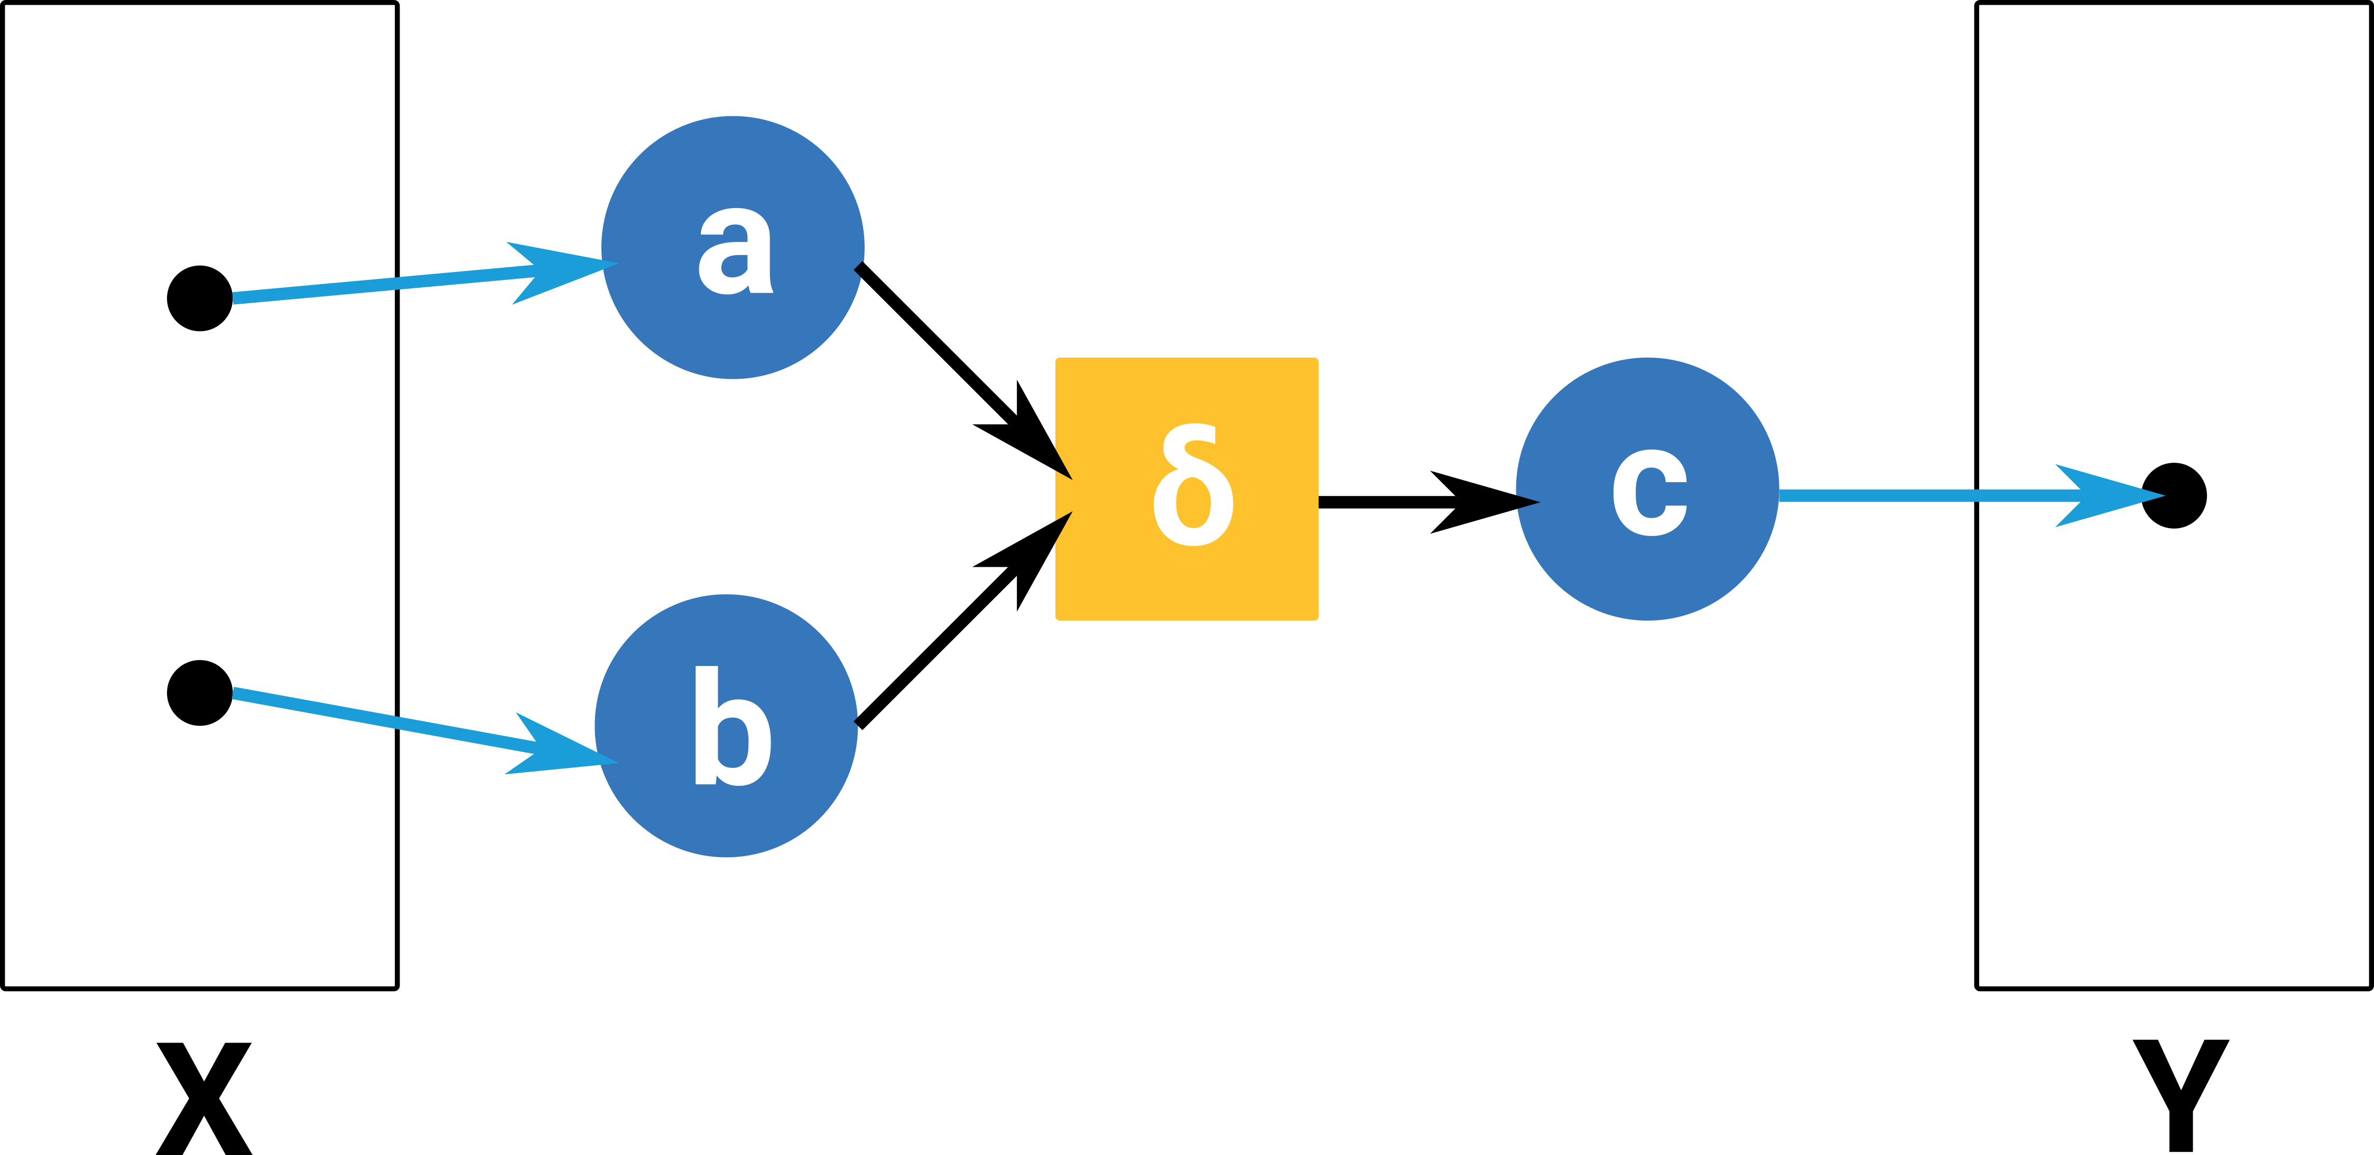
Defining a VDSOL
Notions of state, objects, X and Y
Notion of change of state as the morphism: P: X ↛ Y
We use a process algebra to represent our morphisms P: X ↛ Y, in this case, Petri-nets.
Other representations are possible.
GTRI uses ASTs
UArizona uses GrFNs
These different choices do not limit our ability to collaborate.

Slide 10
Defining a VDSOL
VDSOLs allow us to hide these details under familiar decorations.
Formulation Palettes allow high level abstraction for ease of use and correctness.
Palettes contain Palette Elements
Also contain rules for composition.

Slide 11
Defining a VDSOL
Rules and composition are core to VDSOL definitions.
We currently know what it means to have individual (atomic) elements.
What does it mean to link them?

Slide 12
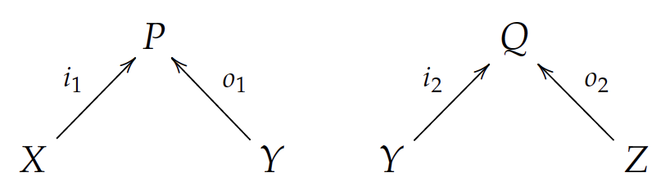
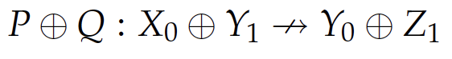
VDSOLs Are Compositional
A VDSOL needs rules for composing Palette Elements.
Elements can be:
Atomic
Composed
Rules for composition
Parallel

Slide 13
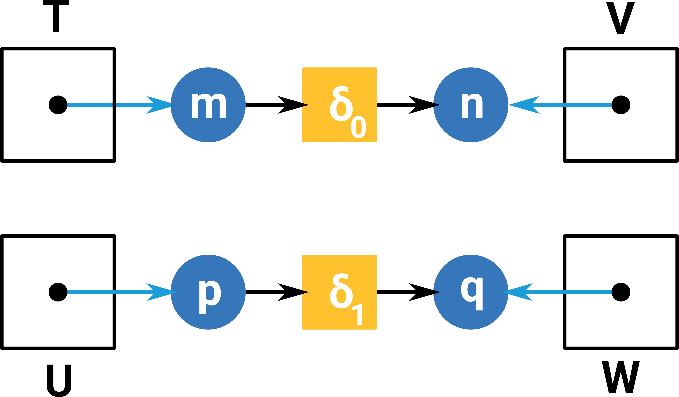
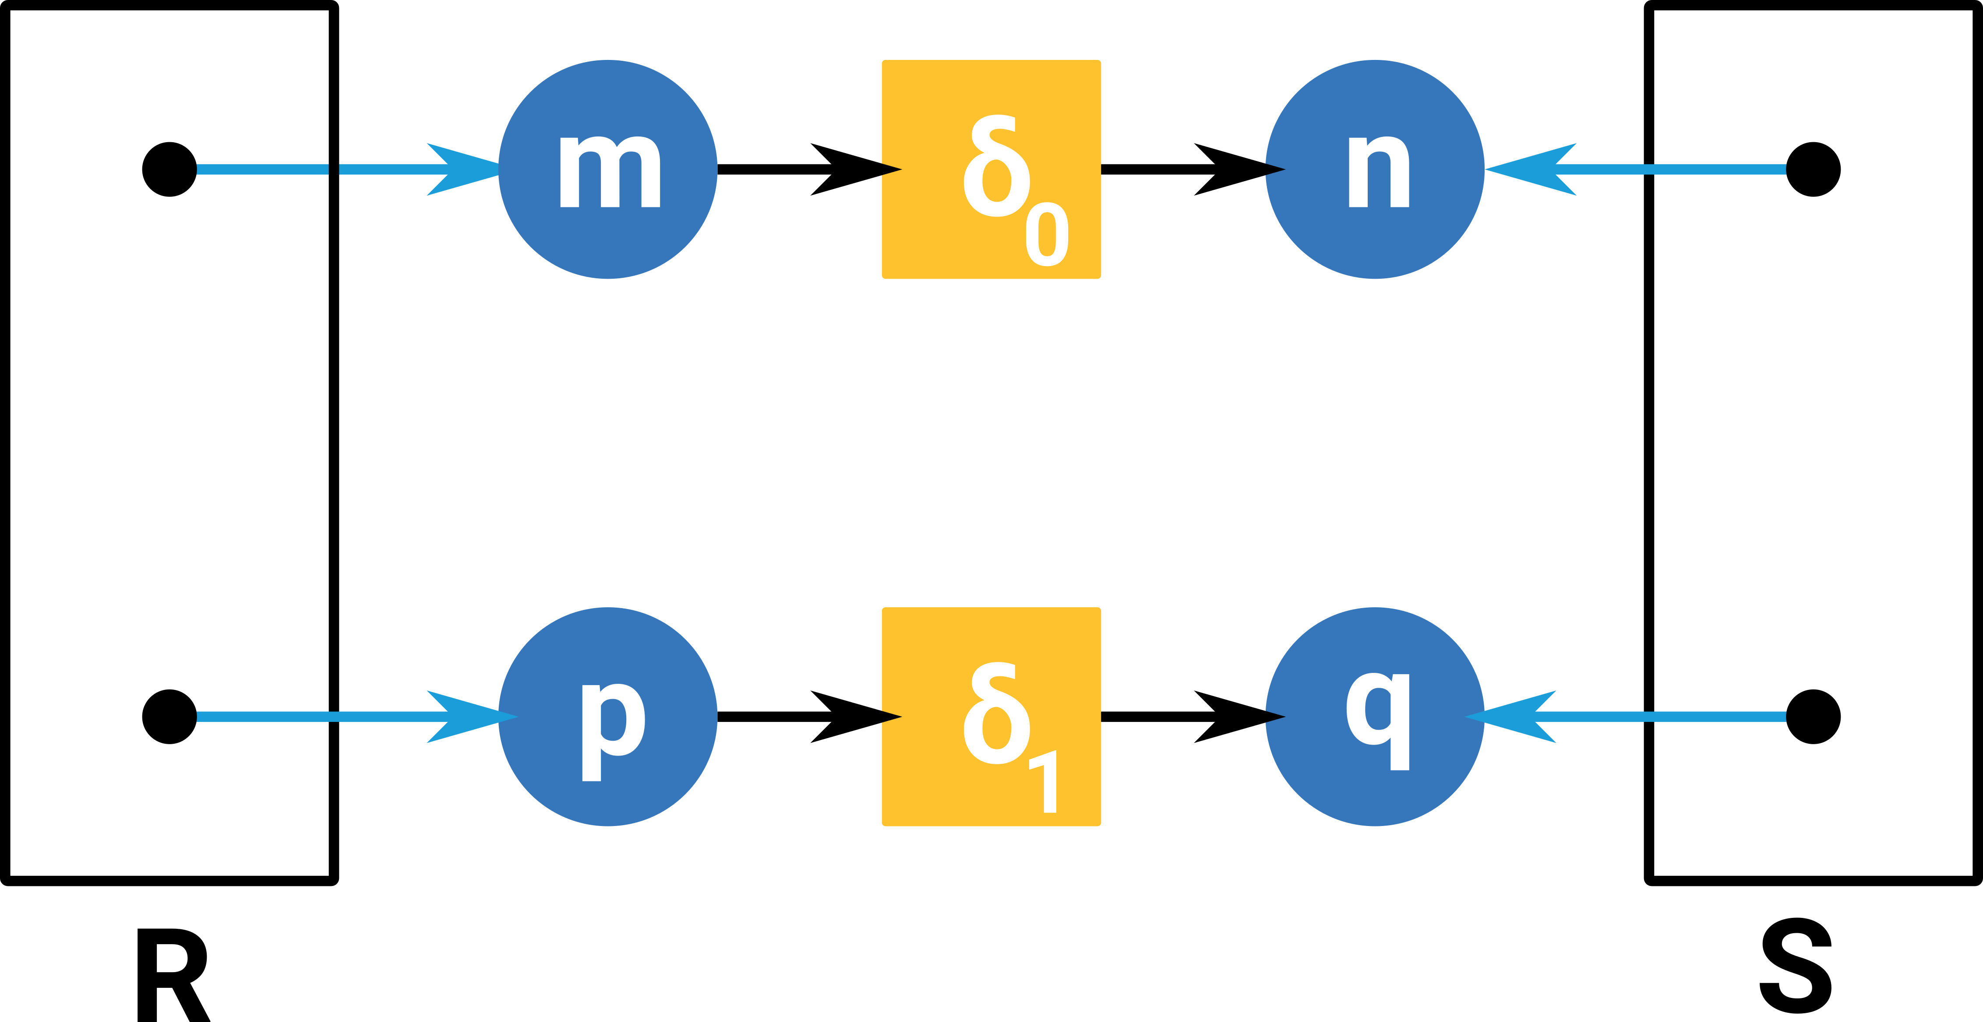
VDSOLs Are Compositional

Slide 14
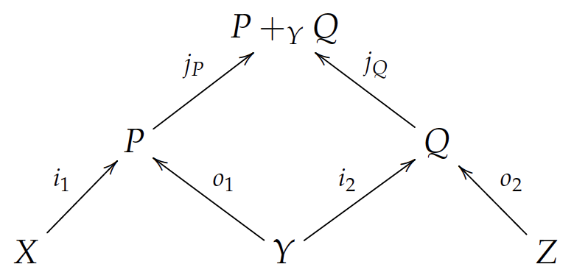
VDSOLs Are Compositional
A VDSOL needs rules for composing Palette Elements.
Elements can be:
Atomic
Composed
Rules for composition
Parallel
Series

Slide 15
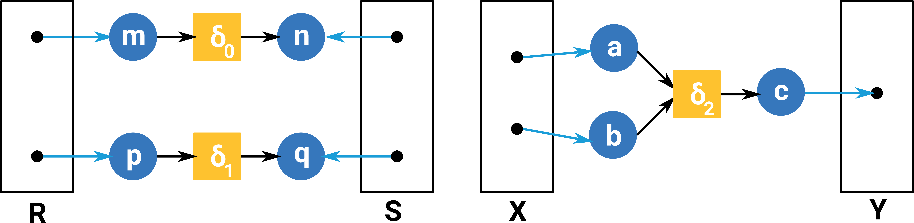
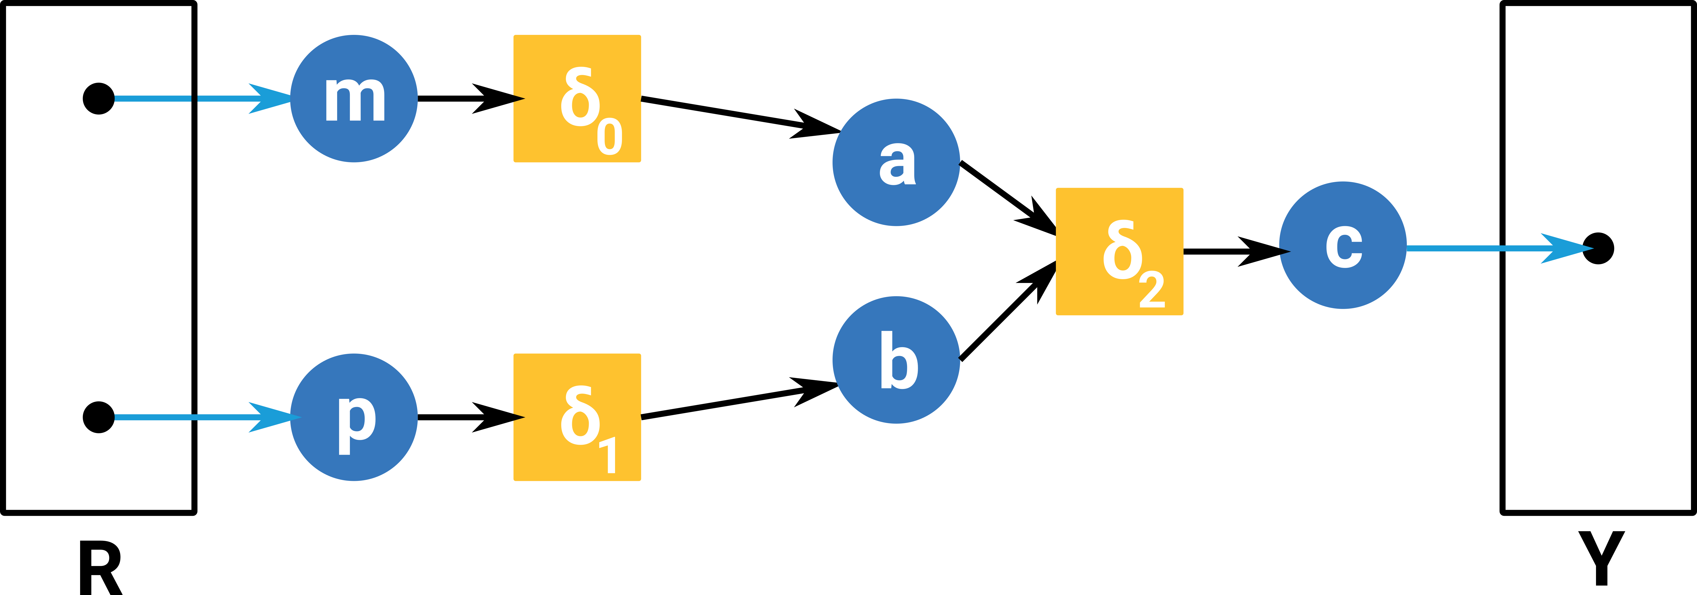
VDSOLs Are Compositional

Slide 16
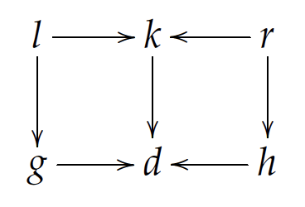
VDSOLs Are Compositional
A VDSOL needs rules for composing Palette Elements.
Elements can be:
Atomic
Composed
Rules for composition
Series
Parallel
Substitution

Slide 17
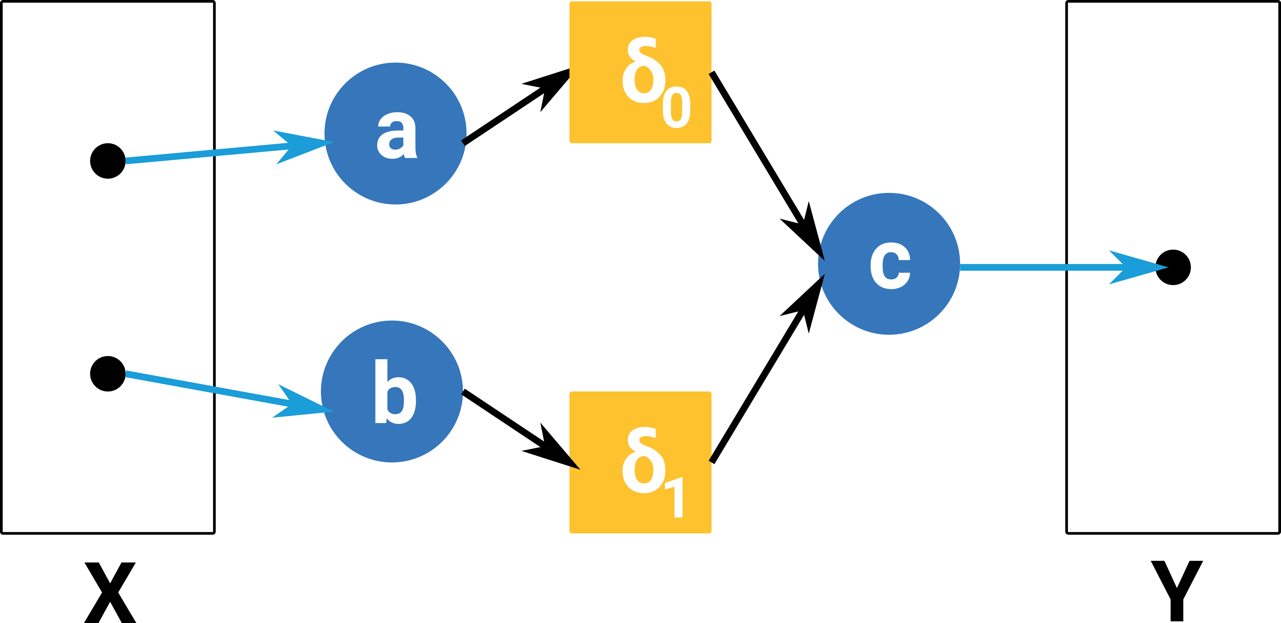
VDSOLs and Substitution
l
r
Given a notion of “compatibility” of elements, we’d like to easily define how to replace one with another.
Invariants
Original
Transformed
Model with “a copy” of l
Model with “copy” of l substituted for r

Slide 18
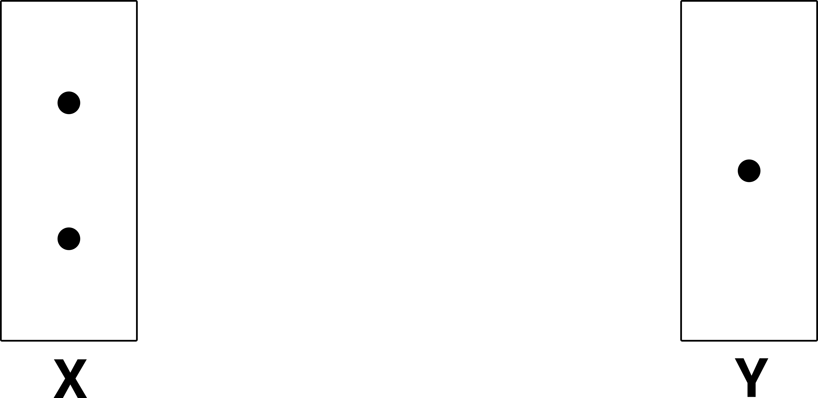
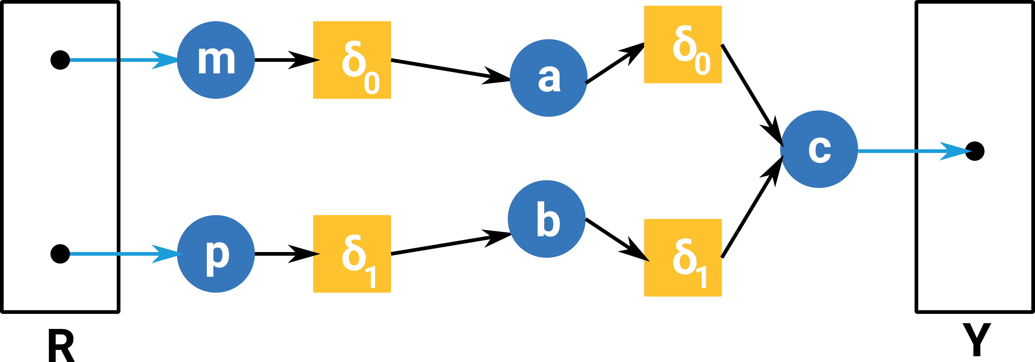
VDSOLs and Substitution
l
k
r

Slide 19
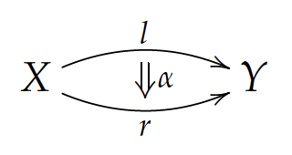
VDSOLs and Substitution
Our invariants, k, in substitution rules provide us something rather interesting.
k tells us what doesn’t change when substituting r for l
k also forms a sort of “morphism signature” or “morphism type”

Slide 20
VDSOLs and Substitution
“Morphism signatures” or “Morphism types” tell us when the abstraction represented by a Palette element represents something structurally similar.
This becomes useful for formalism inference.

Slide 21
Formulation Inference

Slide 22
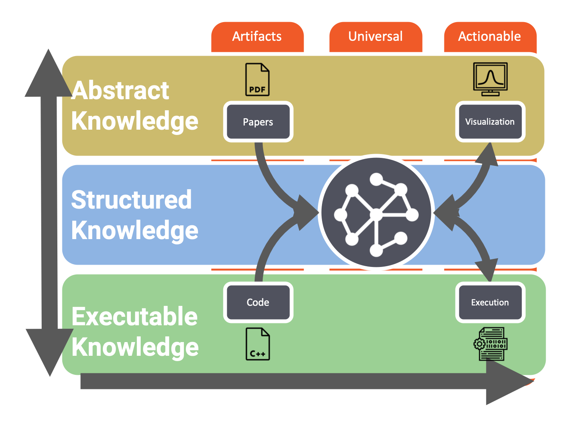
Formulation Inference
Transform artifacts captured in executable knowledge and abstract knowledge
Into actionable elements of abstract knowledge

Slide 23


Formulation Inference
Moving up the modeling stack.
How do we understand the ontological significance of artifacts?
Grounding: 0
Grounding: 2
Grounding: 1

Slide 24
Formulation Inference
Grounding: 0
Grounding: 2
Grounding: 1

Slide 25
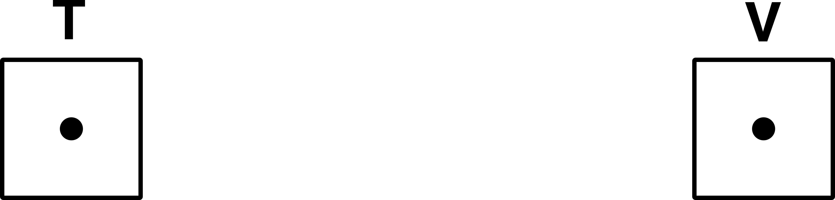
Formulation Inference
Grounding: 0
{
,
}
Grounding: 0

Slide 26
Formulation Inference: Ontology Search
Using the “signature” and grounding, we search a decorated ontology.
The ontology is decorated with sets of:
{Signature, grounding, type, representation}
Where signature, type, and representation can be null.
Find the elements in the ontology decorated with matching groundings.
Right now we use substring match to find these elements.
Search until we find an element of the ontology with a “complete” decoration , or until we exhaust our search.

Slide 27
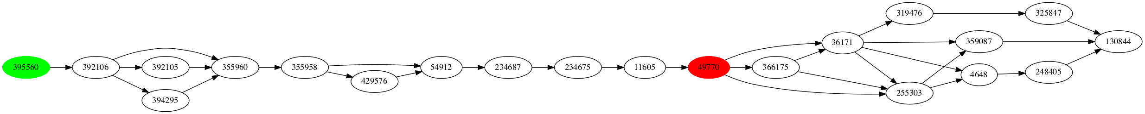
Formulation Inference: Ontology Search
H1N1v Grounding in SNOMED Ontology

Slide 28
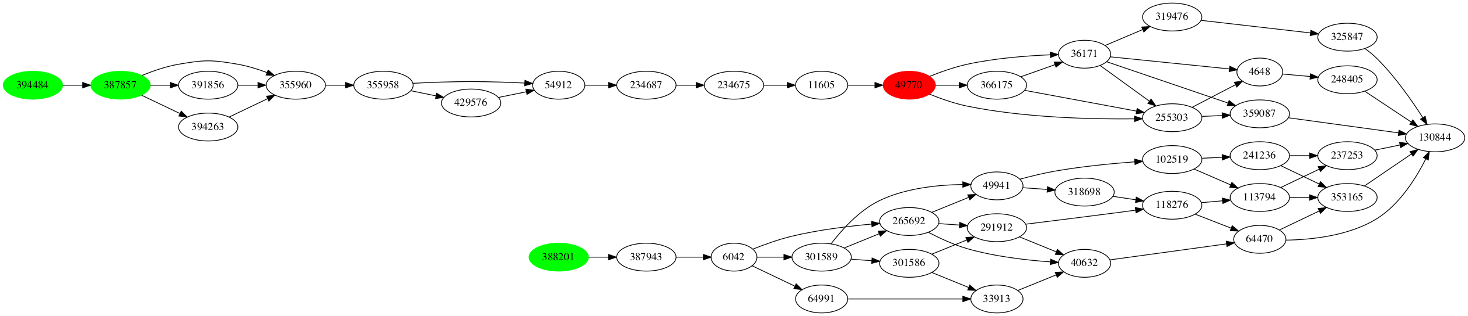
Formulation Inference: Ontology Search
H3N2v Grounding in SNOMED Ontology

Slide 29
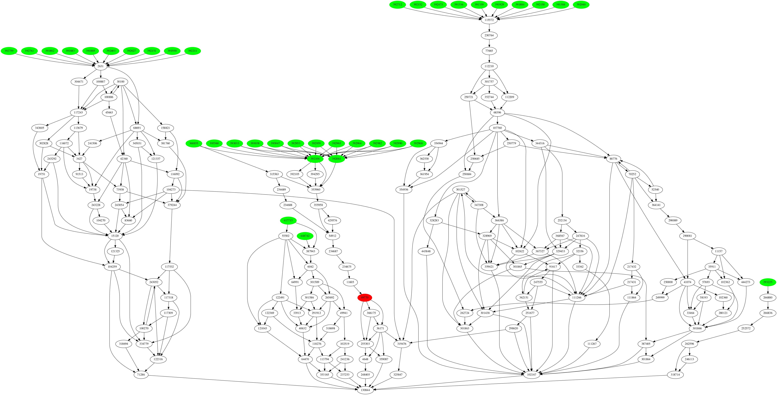
Formulation Inference: Ontology Search
H1N1 Grounding in SNOMED Ontology

Slide 30
Formulation Inference: Ontology Binding
Attempt to bind Structured Knowledge representations to new palette elements, forming Abstract Knowledge representations.
H1N1
{
,
}
H1N1

Slide 31
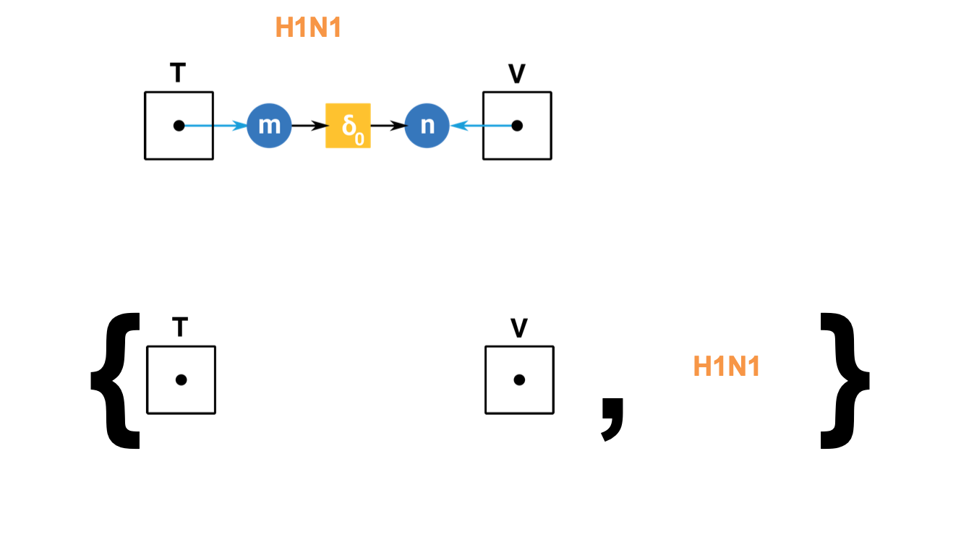
Formulation Inference: Ontology Binding
Attempt to bind Structured Knowledge representations to new palette elements, forming Abstract Knowledge representations.
Completely decorated ontology element, ”virus (organism)”
H1N1 (organism)
H1N1 Vaccine

Slide 32
Formulation Inference: Ontology Binding
H1N1
{
,
,
,
}
Virus (organism)
Verb

Slide 33
Formulation Inference: Ontology Binding
l
k
r
Signature found at “virus (organism)”
Structured Knowledge extracted from artifacts

Slide 34
Formulation Inference: Palette Extension
We can extending existing formulation palettes with new, inferred, palette elements.

Slide 35
Formulation Inference: Palette Extension
We can extending existing formulation palettes with new, inferred, palette elements.

Slide 36

Formulation Inference: Summary
Formulation Inference is an attempt to automatically connect an open graph in Structured Knowledge to the an element in Abstract Knowledge, often an element which does not already exist and must be inferred.
When Formulation Inference fails…
No grounding is found
Create an ungrounded element, and ask for the user’s input.
The wrong grounding is found
Allow the user to modify the results of formulation inference.

Slide 37
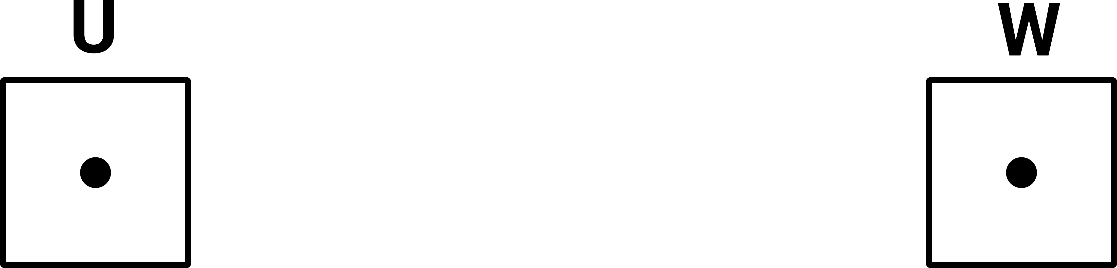
Formulation Inference: Future Work
Decorate the signatures with type information.
T – Persons
V – Sick persons
U – Sick persons
W – Immune persons

Slide 38
Formulation Inference: Future Work
Decorate the signatures with type information.
More domain information than simple arity provides.
Allows for more sophisticated checks during Model Formulation.
Noun grounding might provide something akin to typing.

Slide 39
Design of Experiments

Slide 40
Design of Experiments
Building a model is not enough.
We want:
Model:Model comparison
Model:Data comparison
Algebra on measures for complex comparisons

Slide 41



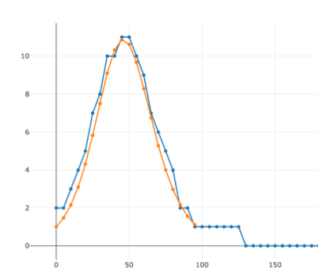
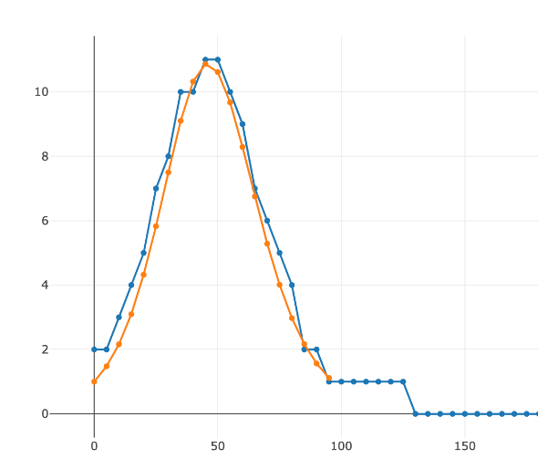
Model:Model Comparison
Given a system model and a measure,
Compose them to get a computable model.
Compile the computable model to executable code.
Run the code to solve the model.
⊗

Slide 42
Model:Model Comparison
Two models cannot be compared directly.
Two models must be compared with respect to measures that are hypothesized to be identical.
Models can be compared for:
Similarity
Bisimilarity
Some defined objective function.
⊗
⊗

Slide 43
Model:Data Comparison
Data is the result of solving a model composed with a measure.
Empirical data is similar, but for an inaccessible model.
⊗

Slide 44
Model:Model/Model:Data Comparison
Given a model M
and measure n
The result of solving M composed with n is:
f(M⊗n) → r
Data is the result of a similar process, but executed on the “hardware” of the real world.

Slide 45
Model:Model/Model:Data Comparison
Database of results of
f(M⊗n) → r
for values of M and n of interest.
n₀
d
r
r
M₀
M₁
??
r
r
n₁
d

Slide 46
Model:Model/Model:Data Comparison
Allow composition of results using a results algebra
Arbitrary functions on r to generate custom objective functions, hypothesis testing.
n₀
d
r
r
M₀
+
+
M₁
??
r
r
n₁
d

Slide 47
Model:Model/Model:Data Comparison
Design of Experiments
Algorithmically generate variations on a model M_{i}.
Application of DPO-based rules (SemanticModels.jl)
Variation of a (set of) parameter(s) to explore the model space, or fit data.
n₀
d
r
r
M₀
M₁
??
r
r
n₁
d

Slide 48
Design of Experiments
Once we have a (set of) formulated model(s), we want the ability to do something meaningful with them.
Hypothesis test.
Fitting a model to data.
Exploring the local model space.
Store the results of costly exploration intelligently.
Where does this fit in our stack?
Partially in the Abstract layer.
Partially in the Structured layer?

Slide 49

Thank you! Questions? ewdavis@galois.com
Notes:
Leaders in high assurance research and development
Creating trustworthiness in critical systems
Solving your hardest computer science problems

